Slide 1
AC MINOR PROJECT square law modulator using matlab
Batch:02
M. Sai Kishore (171FA05305)
R. V. L. Karthik (171FA05305)
S. Tushar (171FA05362)

Slide 2
Aim/ Objective
To design a square law modulator using matlab
To design a square law modulator in simulink library

Slide 3
BLOCK DIAGRAM OF SQUARE LAW MODULATOR
m(t) +
V1(t)
Non linear device
V2(t)
Band pass filter
sum
S(t)
+
Ac*cos(2*pi*fc*t)

Slide 4
Methodology
Square law modulator, is one of the methods to generate AM (Amplitude Modulated) signals.
In amplitude modulation the amplitude of the carrier wave is varied in proportion to that of message signal.
Square law modulator consists of :
A Non Linear Source
A band pass filter
A carrier signal

Slide 5
The carrier and message signal are connected in series with each other .
They are connected in series such that their sum is given as input to non-linear device.
v1(t)=m(t)+Ac*cos(2*pi*fc*t)
The non-linear device used here, can be a diode or transistor.

Slide 6
The input output relation of Non-linear device is
v2(t)=a*v1(t)+b*v2(t)
Here, a and b are constants.
When, the output of Non-linear device is passed through the bandpass filter, we get our desired output, i.e., Amplitude Modulated signal.
S(t)=Ac[1+ka*m(t)]cos(2*pi*fc*t)
Here ka is amplitude sensitivity.

Slide 7
Program:
clc;
clear all;
close all;
t = 0:0.0001:2;
fs = 10000;
Am = 0.25;
fm = 10;
Ac = 1;
fc = 100;
mt = Am.*cos(2*pi*fm*t);
ct = Ac.*sin(2*pi*fc*t);
v1t = mt + ct;
v2t = v1t + v1t.*v1t;
order = 3;
fcutlow = fc-fm;
fcuthigh = fc+fm;

Slide 8
[b,a] = butter(order,[fcutlow,fcuthigh]/(fs/2), 'bandpass');
st = filter(b,a,v2t);
figure;
subplot(3,1,1);
plot(t,mt);
title('Message Signal');
xlabel('Time');
ylabel('Amplitude');
subplot(3,1,2);
plot(t,ct);
title('Carrier Signal');
xlabel('Time');
ylabel('Amplitude');
subplot(3,1,3);
plot(t,st);
title('Modulated Signal');
xlabel('Time');
ylabel('Amplitude');

Slide 9
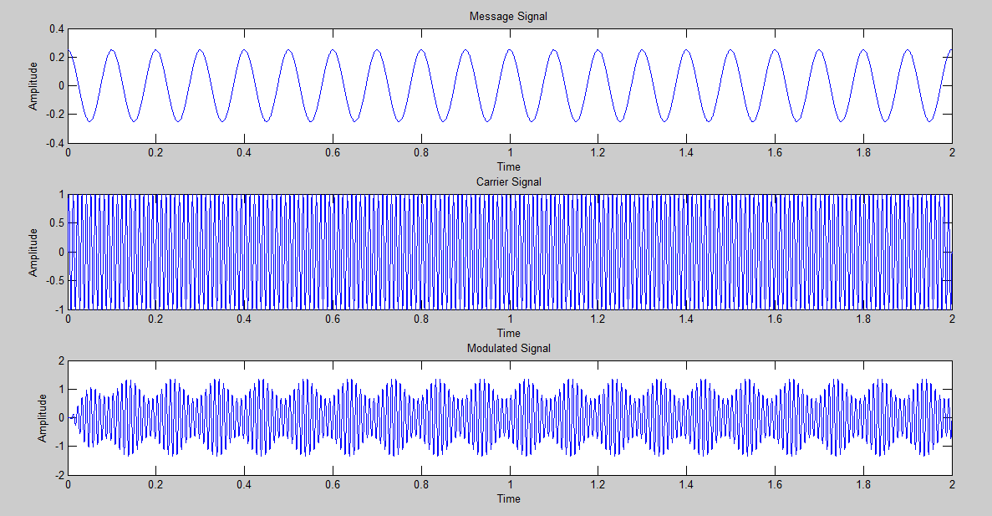
Wave forms:

